Slide 1
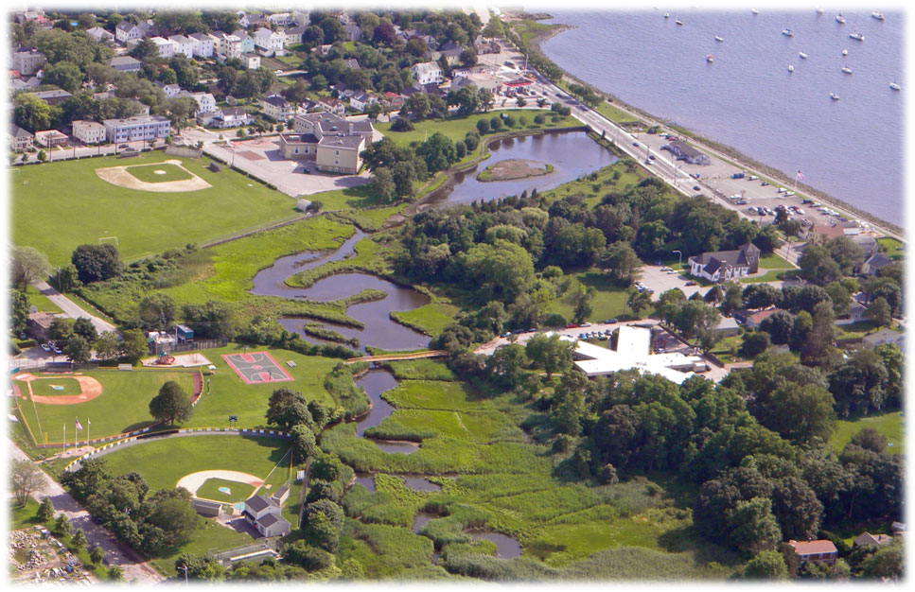
BRISTOL’S BEAUTIFUL PARKS

Slide 2
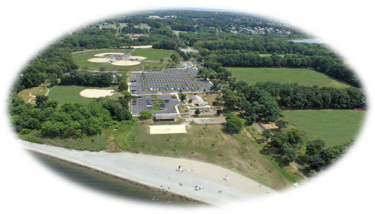
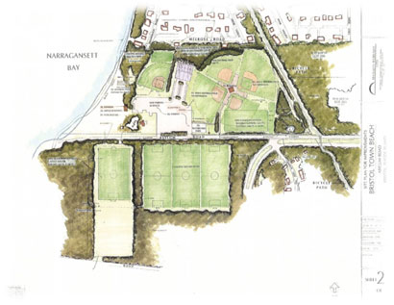
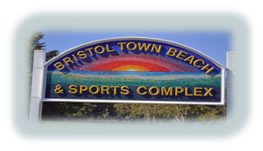
Bristol Town Beach & Sports Complex
The Town Beach and Sports Complex is a 47.15 acre park located near the entrance to Colt State Park. It features a pebbly beach with seasonal lifeguards, a large grassy expanse with a playground, many picnic tables, beach volleyball court, pavilion and ample parking.
The Sports Complex includes five baseball/softball fields, two tennis courts, two basketball courts, a roller hockey arena, two Bocce Courts, one Horseshoe Court, three Soccer fields, two large multipurpose fields, a 5 mile cross country fitness trail with exercise equipment, and a skate park.
A concession stand is open from Memorial Day weekend through Labor Day. It is the office for the Department of Parks and Recreation, as well as home for “Camp Poppasquaw”. It boarders the beautiful Colt State Park and the East Bay Bike Path.

Slide 3
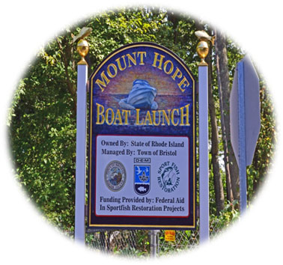
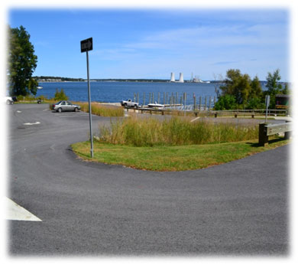
Mount Hope Boat Launch
The Mount Hope Boat Launch is a new park constructed by the Rhode Island Department of Environmental Management funded through the Federal Aid In Sportfish Restoration Project. It is a scenic park located off Annawamscutt Drive. It is fully ADA handicapped accessible, has a pavilion and park benches. Plenty of trailer parking and access to the Kickemuit River in Narragansett Bay.

Slide 4
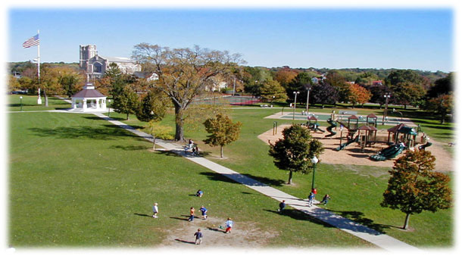
Bristol Town Common
The Bristol Town Common is a 7.08-acre site for numerous activities at all times of the year. Located one block east of Hope St., bordered by Wood and High Streets on the east and west, respectively. State Street runs along the North edge and Church runs along the Common's South side. An old-time bandstand used for Concerts on the Common, and the 4th of July Carnival, a lighted tennis court with three courts, basketball court, softball field, and a large playground are some of the features. Summer basketball leagues and tennis lessons are provided.

Slide 5
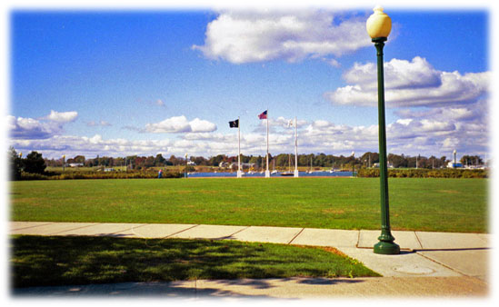
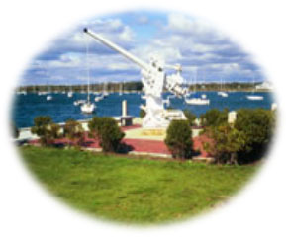
Independence Park
The scenic 4-acre park is located at the head of the East Bay Bike path on beautiful Bristol Harbor and features a surfaced boat ramp, a board walk, concrete walkways, fountain, public restrooms, and beautiful sunsets.
The park is designed for passive recreation and is home of the Labor Day “Last Night” Concert with the Rhode Island Philharmonic.

Slide 6
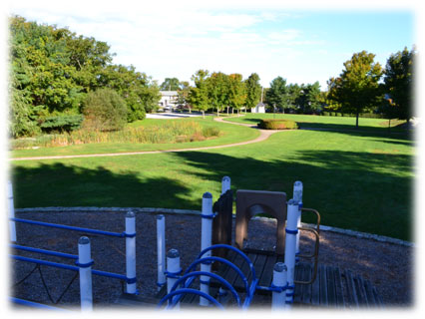
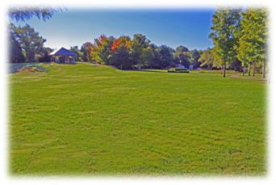
Coelho Park
Coelho Park is a 3.2-acre, large, residential playground, located off Hopeworth Avenue and Jenny Lane, It is designed for families and children of all ages. It includes two playground areas, basketball court, soccer field, concrete walkway, small pond and a pavilion and benches and picnic tables. A great place for a picnic. The pond is used for ice skating in the winter.

Slide 7
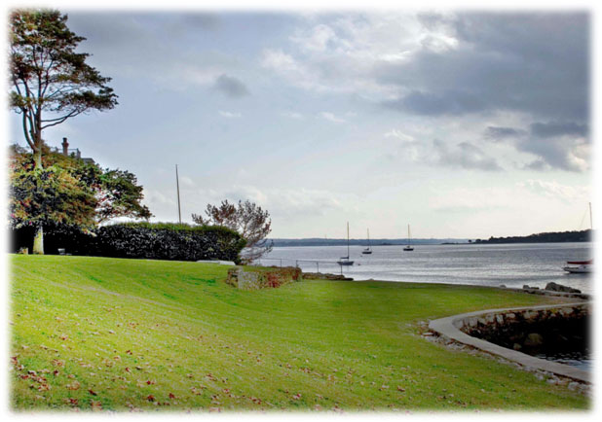
Walley Beach
Walley Beach is a 1.3 acre picturesque park overlooking the beautiful Bristol Harbor. Located next to the Herreshoff dock on Hope Street. It has a small swimming area, a picnic table and beaches. A great place to sit and relax watching the boats or sun bathing.

Slide 8
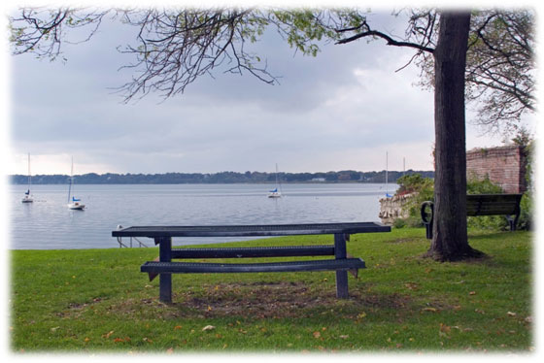
Union Street Beach
Union Street Beach is a small picturesque park overlooking the beautiful Bristol Harbor. Located on Hope Street, at the beginning of Union Street. It has a small swimming area, a picnic table and benches. A great place to sit and relax watching the boats or sun bathing.

Slide 9
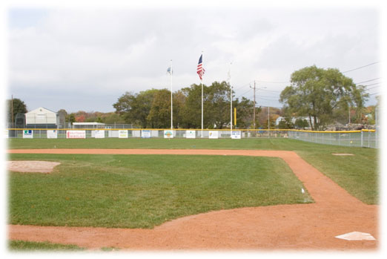
Veterans’ Memorial Park
Home to the King Philip Little League and
Roger Pigeon Memorial field
Veteran’s Memorial Park is Home to the King Philip Little League and Roger Pigeon Memorial field, this newly renovated 8.1-acre park has a major league and minor league baseball field, a basketball court, playground, picnic tables and a parking lot. Two buildings contain bathrooms, storage and concession rooms. It is located at the North end of Wood Street, bordered by Silver Creek, which provides scenic views of swans and ducks.

Slide 10
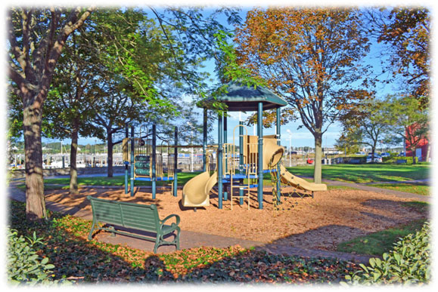
Rockwell Park
Rockwell Park is a 1.2-acre harbor side park at the end of John Street on historic Thames Street. The park has a fairly new dock system for residents as well as some space for transient boaters. The park also has a playground with slides and swings for younger children, a boardwalk and benches.

Slide 11
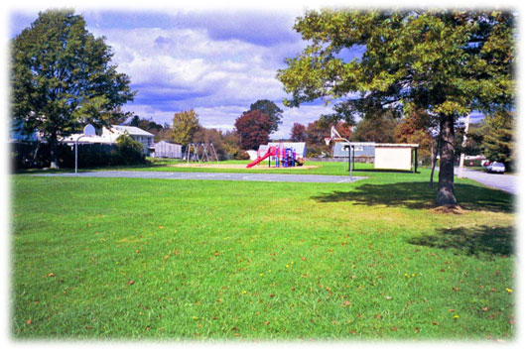
Sowams Playground Park
This 1.4-acre neighborhood park is located on Sweeney Lane. It has a playground, basketball court, a ball field and pavilion. A large multi-purpose field for picnics and football.

Slide 12
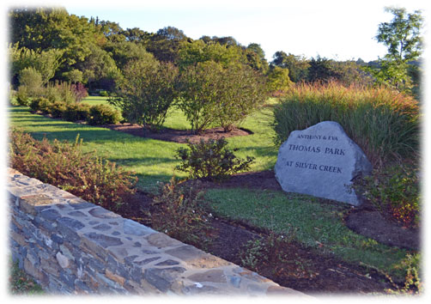
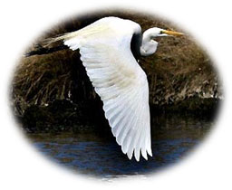
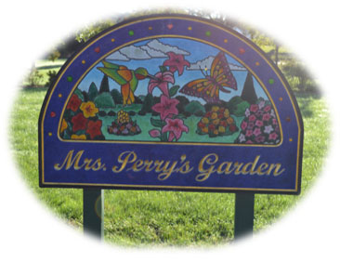
Thomas Park at Silver Creek
Thomas Park at Silver Creek is a 5.1-acre park located on Hope Street at the entrance to downtown Bristol. Thomas Park has recently been renovated into a passive naturalistic park with native plantings and walking paths. The Bristol Parks and Recreation Department has partnered with the Bristol Garden Club, to install “Mrs. Perry’s Garden” a beautiful garden in honor of the Garden Club’s founder. The park has natural grass winding paths throughout the property with benches near scenic overlooks. The public will enjoy, but not interfere, with the natural environment, by bird and animal watching, painting or photographing as well as passive relaxation. This scenic area with an old English garden, restored stone wall and arbor, nature trails, wild flower garden and nature preserve for indigenous plants and wild life, as well as a salt marsh bird sanctuary.

Slide 13
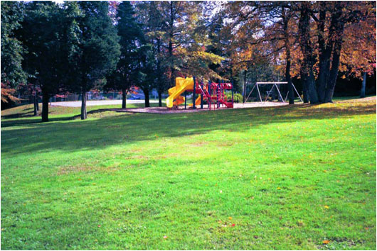
Cedarcrest Park
Cedarcrest Park is a 2-acre neighborhood park located on Fatima Drive. It features a beautiful playground, basketball court and a baseball field. This wooded park is great for picnics.

Slide 14
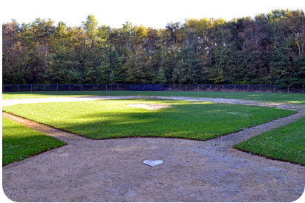
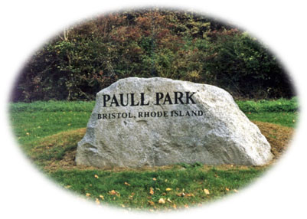
Paull Park
A beautiful 13.2-acre wetland conservation area located across from the Mt. Hope High School, Paull park features Ramos Field, a baseball diamond, swing set and parking. Paull Park is a wetland area with nature trails.

Slide 15
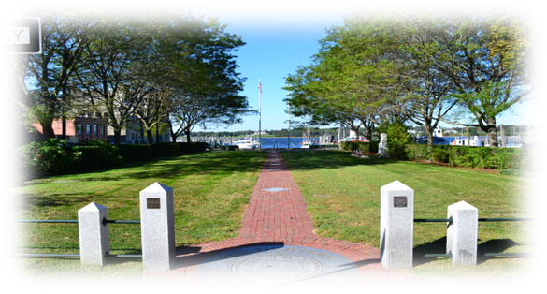
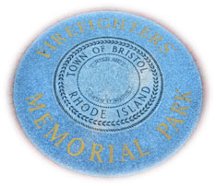
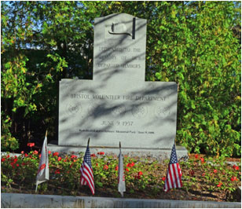
Firefighters’ Memorial Park
This park was formally part of Rockwell Park. In 1995 Fire Chief David Sylvaria requested this park to honor all deceased members of the Bristol Fire Department. As you enter the park you are greeted with a stone which bears the Seal of the Town of Bristol. Then a list of all of Bristol’s Fire Companies: The Board of Engineers, Engine 4, Emergency Rescue Squad, Fire Police, Fireman’s Memorial and Welfare Committee, the former King Philip Steam Engine Co. #1, and Ladies Auxiliary.
Each year on the second Sunday of June, the Bristol Fire Department memorializes its members who have passed away with a parade and a ceremony. When visiting the park, enjoy it and please respect and honor the firefighters of the Town of Bristol.

Slide 16
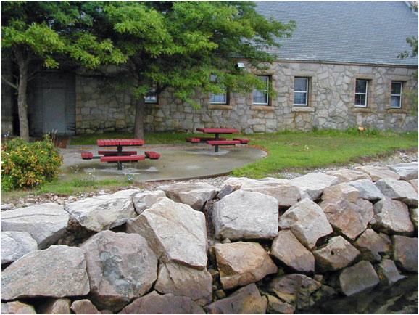
Manny Sousa Park
Manny Sousa park is located on the waterfront of the Harbor Master’s office on Rockwell Dock. This park offers a scenic view of Bristol Harbor and has two picnic tables and restroom facilities.

Slide 17
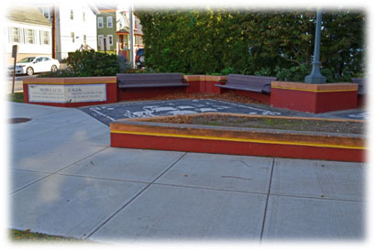
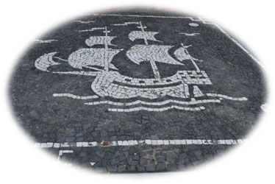
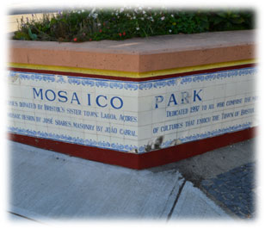
Mosaico Park
Mosaico Park is located on the corner of Wood Street and Franklin Street. It has been designed as a symbol of the friendship and connection that Bristol has with its sister city Logoa, San Miguel, Azores. It embraces the mosaic of our multi cultural community. It has park benches and is a great place to sit and share stories.

Slide 18
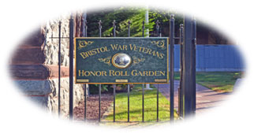
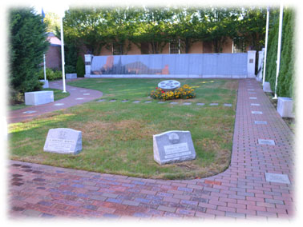
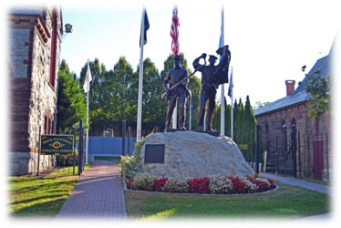
Bristol War Veterans Honor Roll Garden
The Bristol War Veterans Honor Roll Garden is located next to the Bristol Town Hall and the Bristol Visitors Center in the Historic Burnside Building on Hope Street. This garden is designed to pay tribute and to honor all of Bristol’s War Veterans. It is a place to celebrate the lives of the men and women who have given so much to protect the freedoms we all enjoy. Please come for a visit and remember; freedom is never free.

Slide 19
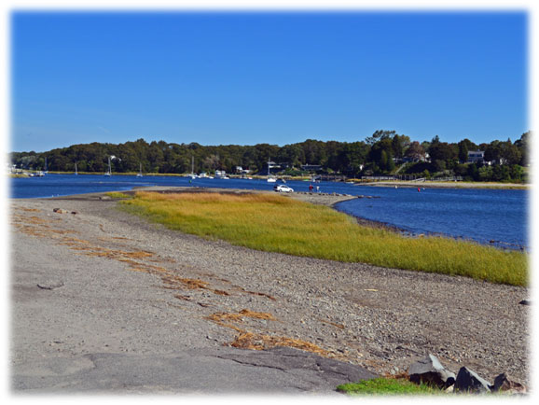
Narrows Boat Ramp
The Narrows Boat Ramp is located at the end of Narrows Road and is a public access right of way to the Kickemuit River on Narragansett Bay. A place to fish, launch a boat or kayak.

